Slide 1

Texas Housing Market Analysis
Data Analytics & Visualization Project #1
Ali Karimi, Simon Castellanos, Jucary Estrada, Francis Escamilla
June 2021

Slide 2
Description & Scope
The goal of the project is to perform an analysis of the housing market in Texas and try to evaluate factors that may be potentially influencing the current trend.
Gather real state inventory data and pricing data for real state, Oil, lumber, copper, etc. To analyze supply demand influences, job market and construction costs. Use the data to evaluate the trends for each, compare it to the housing price trends and determine if there are significant correlations.

Slide 3
Questions (What is triggering rise in prices?)
What is the relation between population growth and number of house inventory?
What is the relation between cost of construction and increase in house prices?
Do oil prices influence demands for homes?
Is the current trend a housing bubble (overinflation of real state prices)? //

Slide 4
Data Resources
FRED Economic Research (https://fred.stlouisfed.org/). Used data from 1995 to 2021
Population Data by Metropolitan Area
All-Transactions House Price Index for Texas
West Texas Intermediate (WTI), Dollars per Barrel
Producer Price Index Copper Wire and Cable
Producer Price Index Iron and Steel
Producer Price Index Lumber
Zillow Housing Data (Housing Data - Zillow Research)
Median Home Values and number of house listing by Metropolitan Area

Slide 5
Data Exploration and Clean Up
Describe the exploration and cleanup process
Discuss insights you had while exploring the data that you didn't anticipate
Discuss any problems that arose after exploring the data, and how you resolved them
Present and discuss interesting figures developed during exploration, ideally with the help of Jupyter Notebook

Slide 6
Analysis Process
Discuss the steps you took to analyze the data and answer each question you asked in your proposal
Present and discuss interesting figures developed during analysis, ideally with the help of Jupyter Notebook

Slide 7
Visualizations and Observations

Slide 8
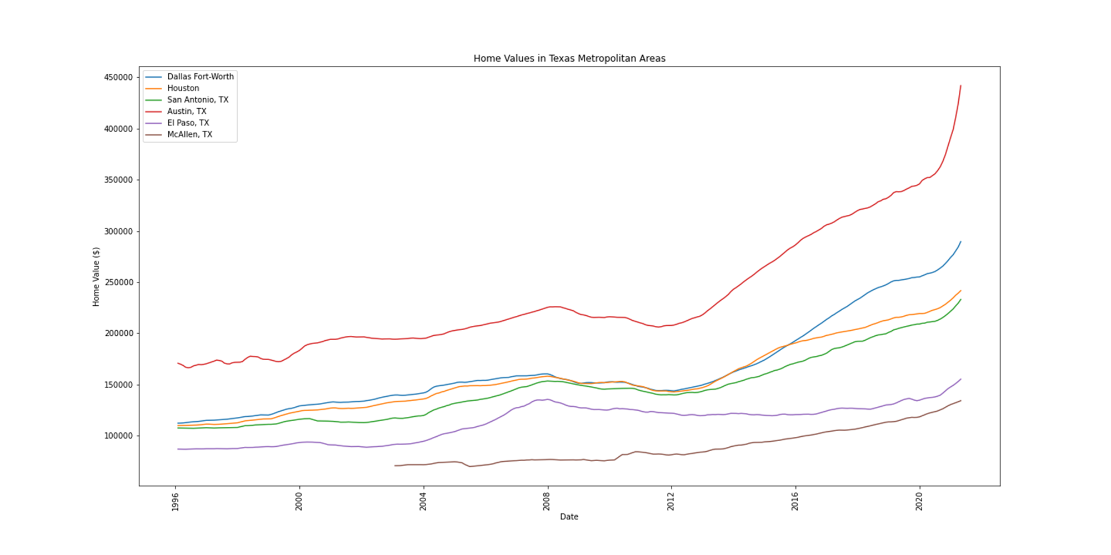
Texas metropolitan areas are experiencing an increase in home values. Austin shows to have higher home values compared to other Texas cities. It also shows to have the most significant increase in prices, followed by Dallas. McAllen on the other hand has the lowest valued homes and although the price values are increasing, it seems to be at a steady pace relative to the rest of the state.

Slide 9
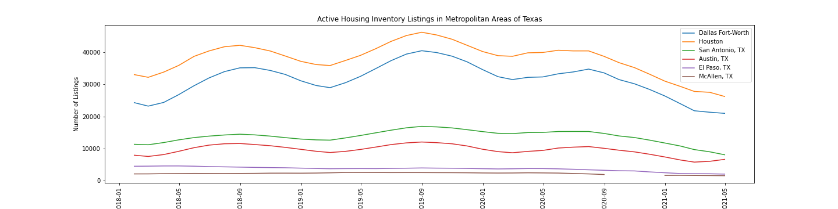
Listing Inventory

Slide 10
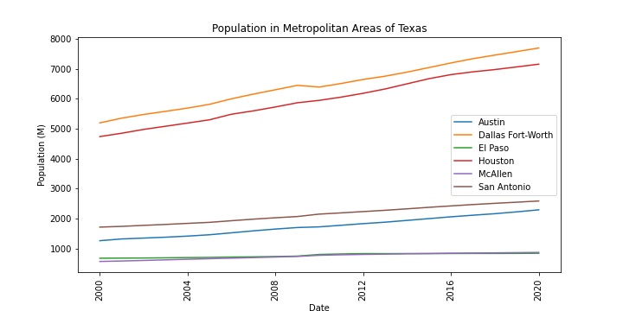

Slide 11
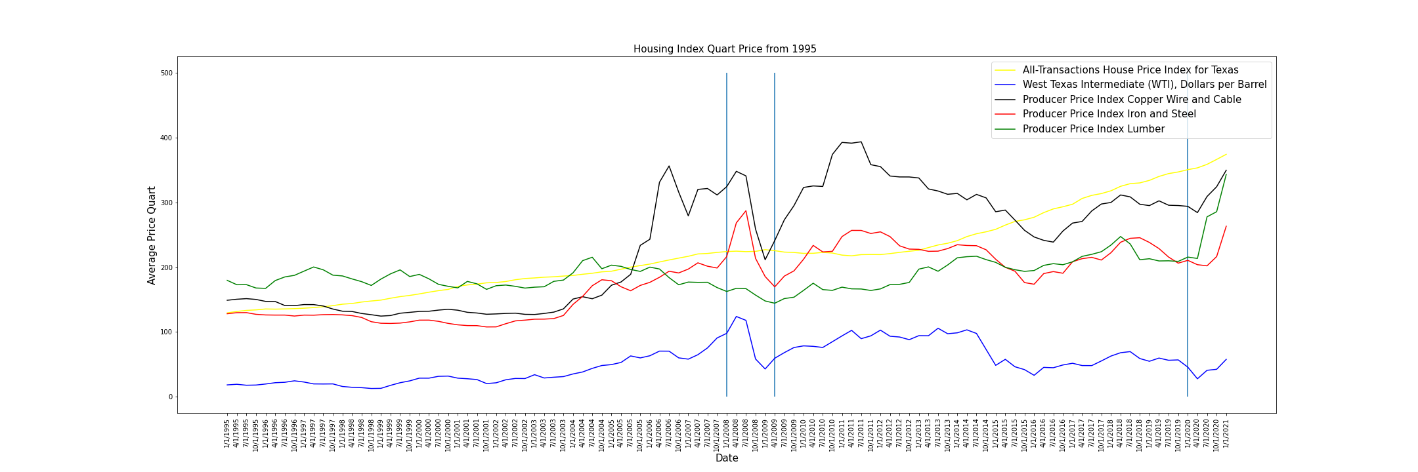

Slide 12
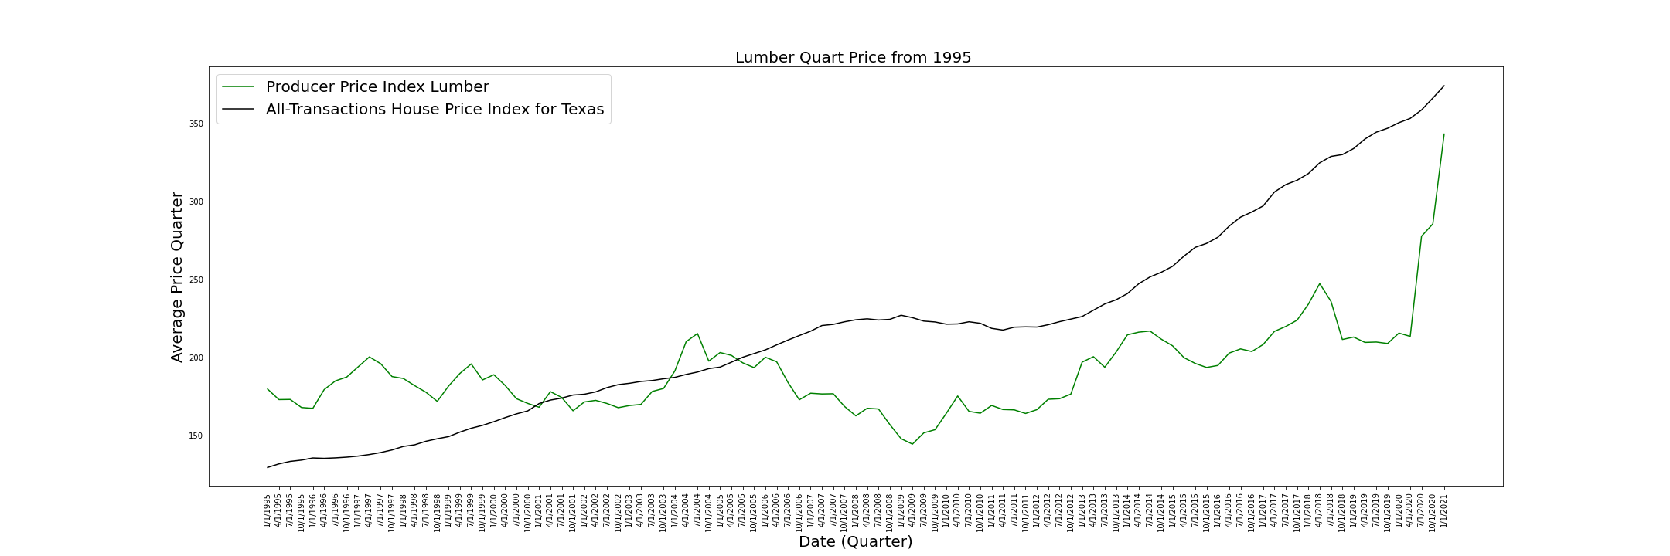

Slide 13
Post Mortem
Discuss any difficulties that arose, and how you dealt with them
Discuss any additional questions that came up, but which you didn't have time to answer: What would you research next, if you had two more weeks?

Slide 14
Questions?

